Slide 1

FLIGHT PRICE PROJECT
BY: TEJENDRA SONI

Slide 2
OBJECTIVE:
Data Collection You must scrape at least 1500 rows of data. You can scrape more data as well, it’s up to you, More the data better the model In this section you must scrape the data of flights from different websites (yatra.com, skyscanner.com, official websites of airlines, etc.). The number of columns for data doesn’t have limit, it’s up to you and your creativity. Generally, these columns are airline name, date of journey, source, destination, route, departure time, arrival time, duration, total stops and the target variable price. You can make changes to it, you can add, or you can remove some columns, it completely depends on the website from which you are fetching the data.
Data Analysis After cleaning the data, you must do some analysis on the data. Do airfares change frequently? Do they move in small increments or in large jumps? Do they tend to go up or down over time? What is the best time to buy so that the consumer can save the most by taking the least risk? Does price increase as we get near to departure date? Is Indigo cheaper than Jet Airways? Are morning flights expensive?
Model Building After collecting the data, you need to build a machine learning model. Before model building do all data pre-processing steps. Try different models with different hyper parameters and select the best model. Follow the complete life cycle of data science. Include all the steps like 1. Data Cleaning 2. Exploratory Data Analysis 3. Data Pre-processing 4. Model Building 5. Model Evaluation 6. Selecting the best mode

Slide 3
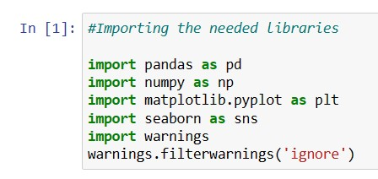
IMPORTING REQUIRED LIBRARIES AND DATABASE:

Slide 4
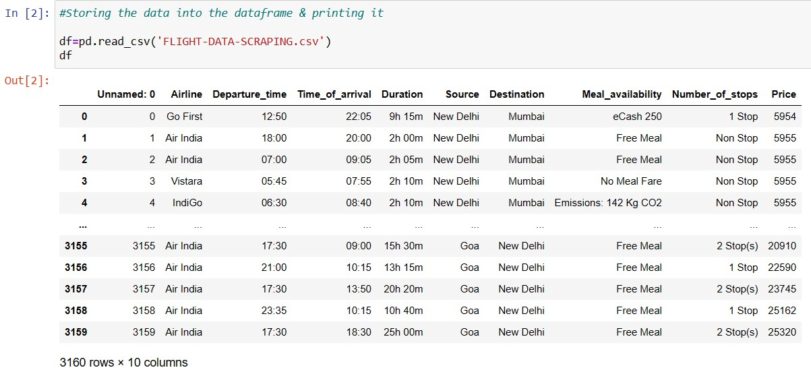
Our dataset has 3160 rows and 10 columns.

Slide 5
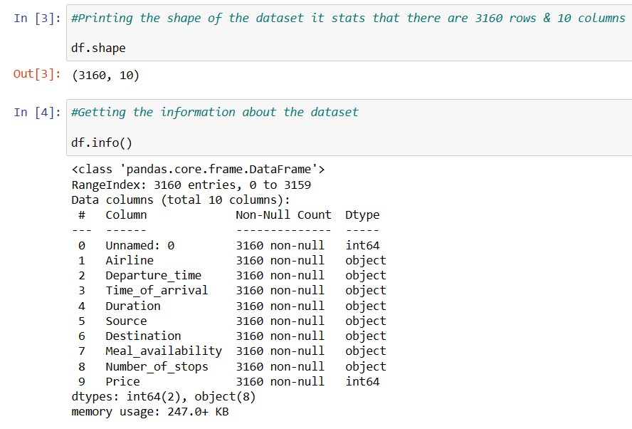
Printing the shape of the dataset
&
Printing the information about the dataset
Only unnamed: 0 & Price column are of integer type rest all the variables are of object type

Slide 6

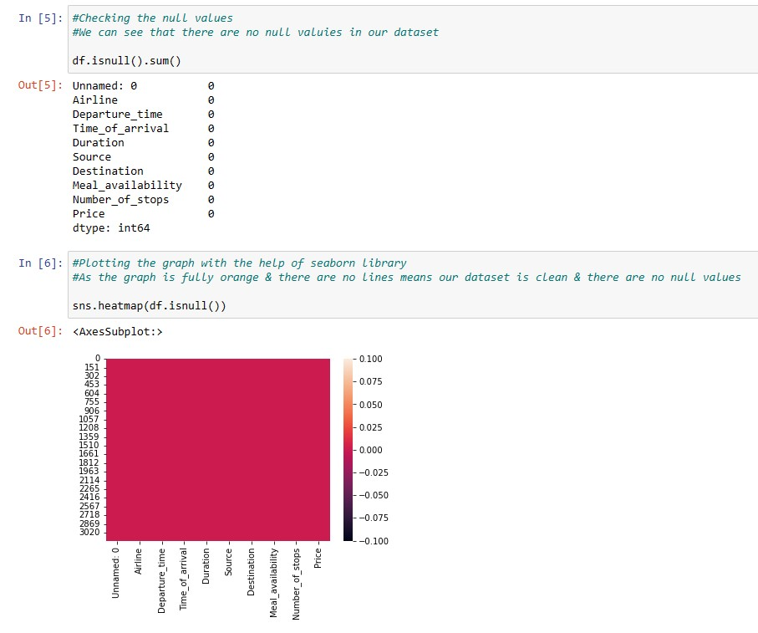
CHECKING NULL VALUES

Slide 7
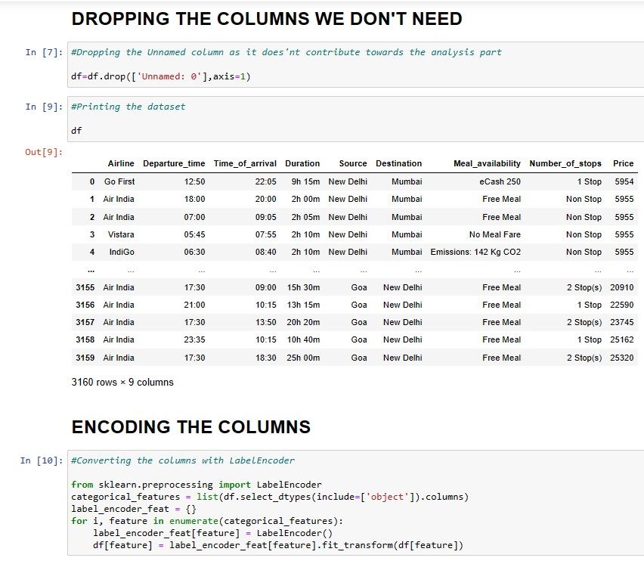
DROPPING & ENCODING

Slide 8
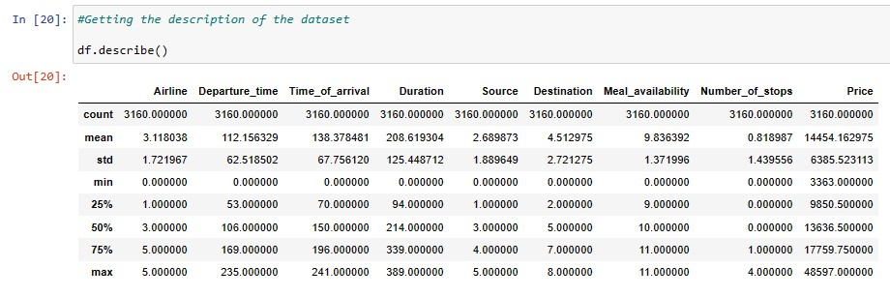
STATISTICAL SUMMARY

Slide 9
VISUALIZATION:

Slide 10
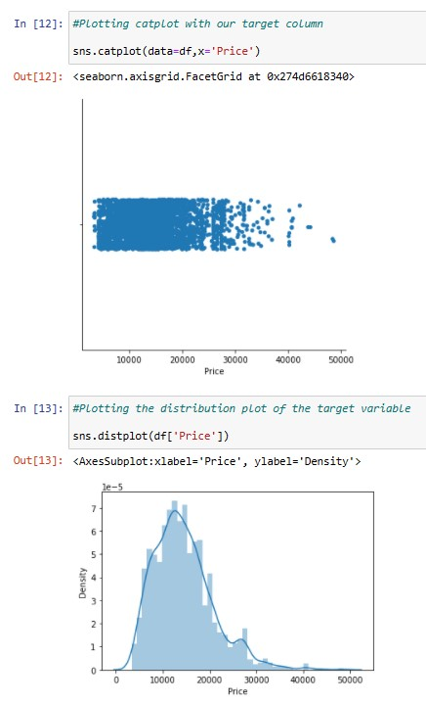
Plotting the cat plot & distribution plot of our target variable PRICE
In the graph 1 we can determine that the PRICE is more concentrated
towards 0-25000 approx.
In the graph 2 we can determine that our target variable PRICE column
is almost normally distributed

Slide 11
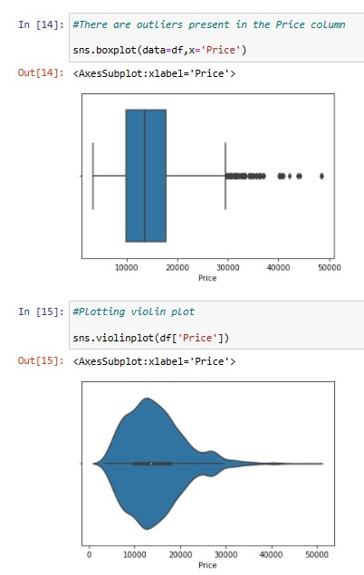
In the graph 1 we can determine that there are some outliers in our target variable PRICE
We will remove it afterwards
&
In the graph 2 we can see the distribution of PRICE through VIOLINPLOT

Slide 12
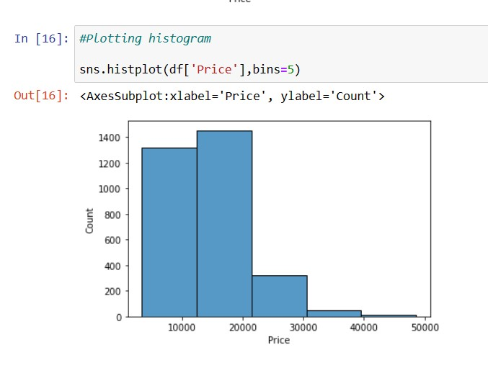
In the graph we are plotting the histogram plot of the PRICE & we can see that at ₹20000 most of the fares occurred i.e., 1400+

Slide 13
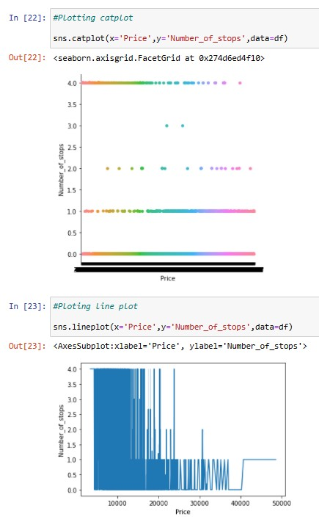
With this graph we can determine that as the price increases the number of stops of FLIGHTS decreases
As we can see when the graph goes from 15000 to 30000
we can clearly see that the number of stops has been decreased

Slide 14
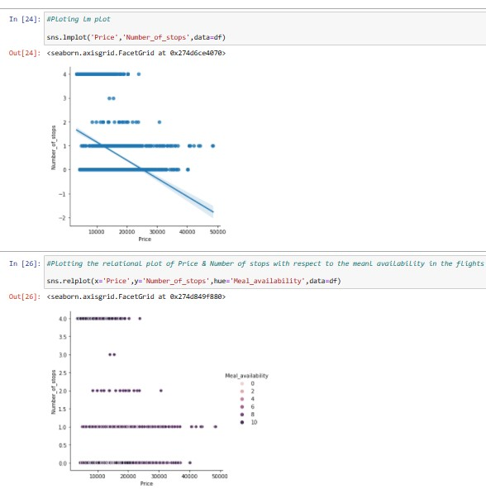
As we have seen in the above graphs
This graph also states that there is negative relationship b/w PRICE & NUMBER OF STOPS
Printing the relational plot of PRICE & NUMBER OF STOPS with respect to the MEAL AVAILABILITY in the FLIGHT

Slide 15
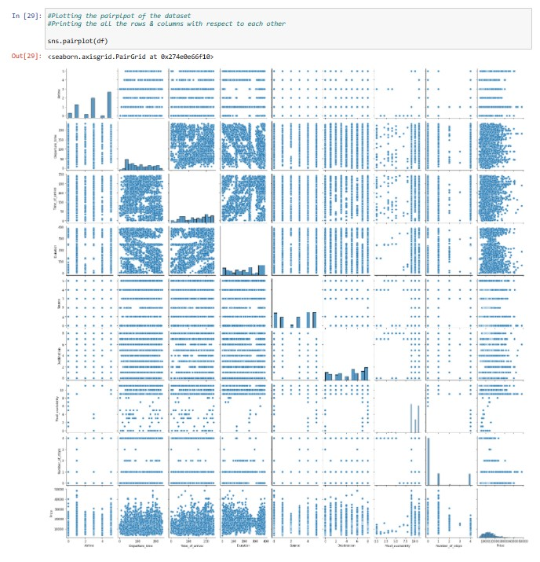
Plotting all the columns with respect to the rows
Plotting the pair plot of the whole dataset

Slide 16
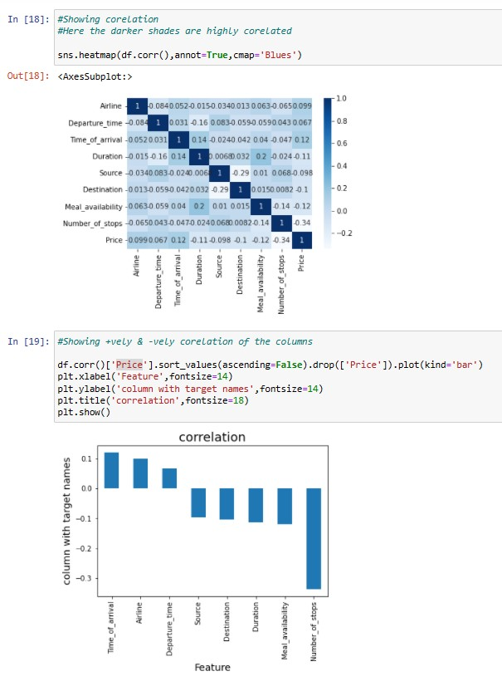
CORRELATION
Plotting the graph of the correlation
Also, we can here determine that all the darker shade of columns are highly
correlated
Time of arrival is most positively correlated
Then, Airline
Then, Departure time
& the remaining columns are negatively correlated
Number of stops is most negatively correlated
Then, Meal availability
Then, Duration
Then, Destination
Then, Source

Slide 17
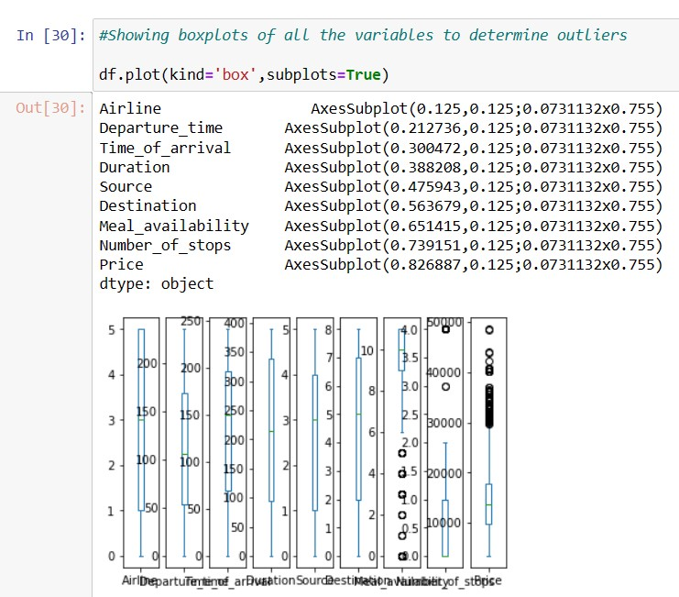
OUTLIERS:
There are some outliers in all the columns
So, we will remove them & will make our dataset ready
for analysis

Slide 18
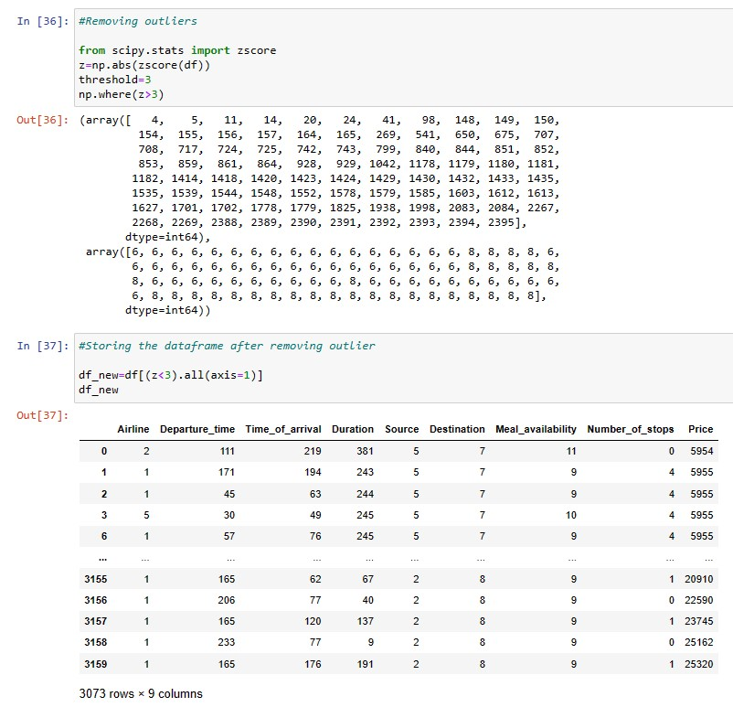
REMOVING OUTLIERS
Removing the outliers & storing the filtered data into df_new

Slide 19
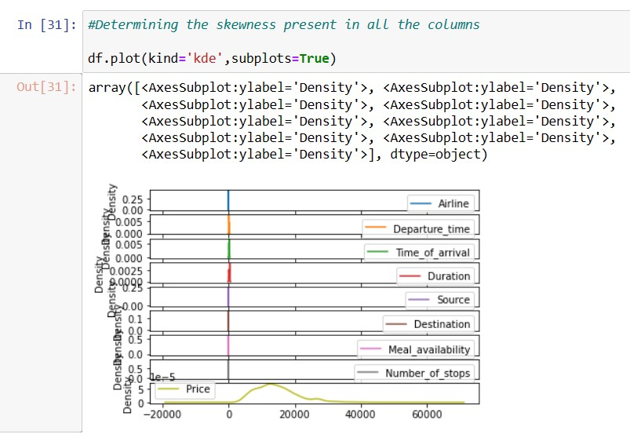
SKEWNESS
There is no high skewness is present in our
Dataset
Still, we will check on it individually & will try to
remove the skewness till the maximum extent
that we can

Slide 20
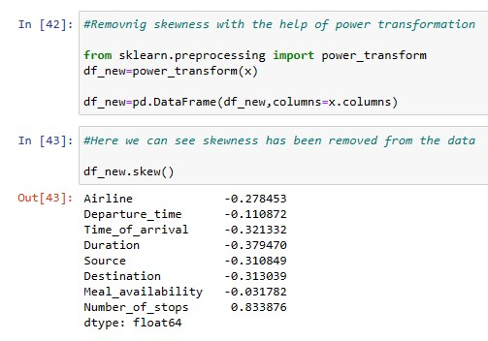
REMOVING SKEWNESS
Using power transformation technique, we are
trying to remove skewness

Slide 21
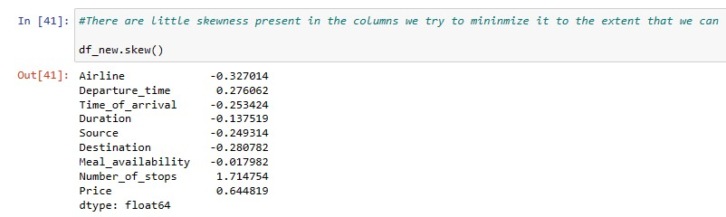
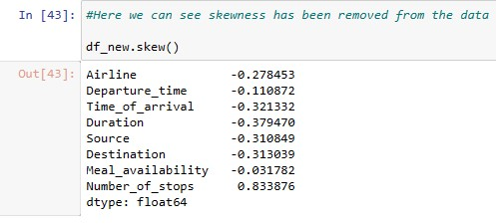
Skewness checking
Skewness removal

Slide 22
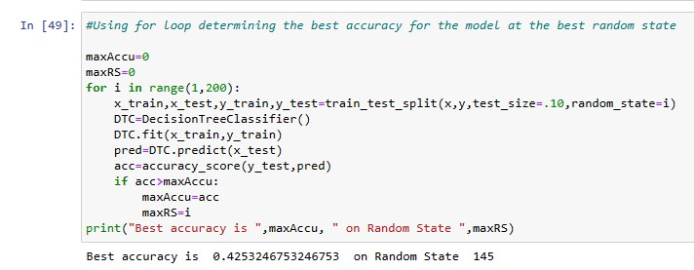
FINDING BEST RANDOM STATE:

Slide 23
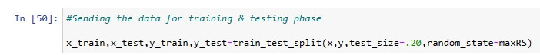
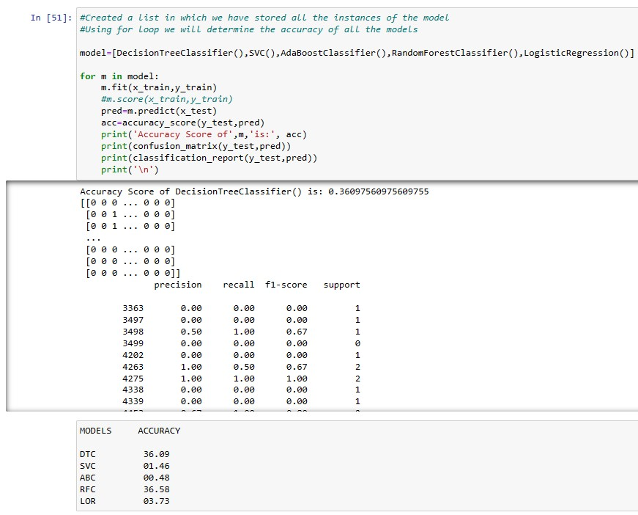
MODEL/S DEVELOPMENT AND EVALUATION:

Slide 24
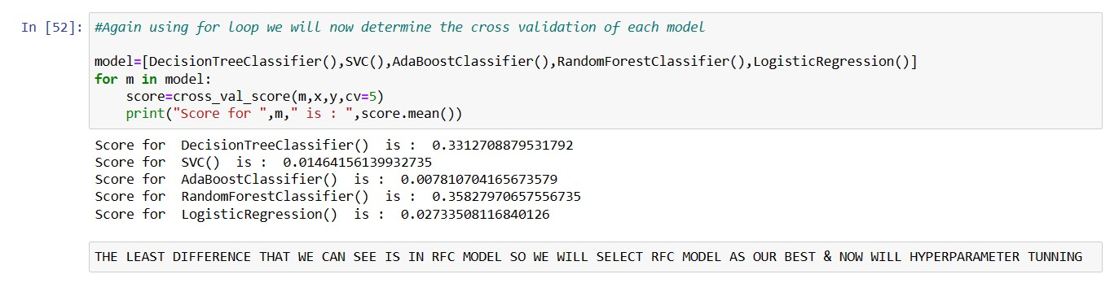
WE CAN SEE RFC HAS 36.58% ACCURACY
We are cross validating each model & then we will select the best model for our dataset
Again, we are selecting the RFC as our best model

Slide 25
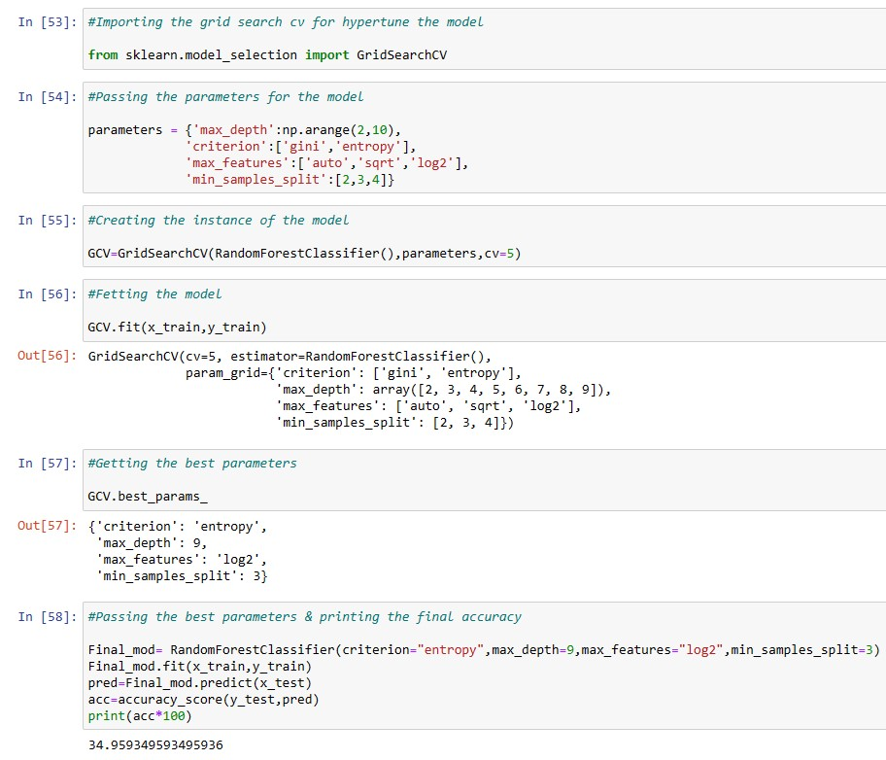
Hyper parameter tunning our best model

Slide 26
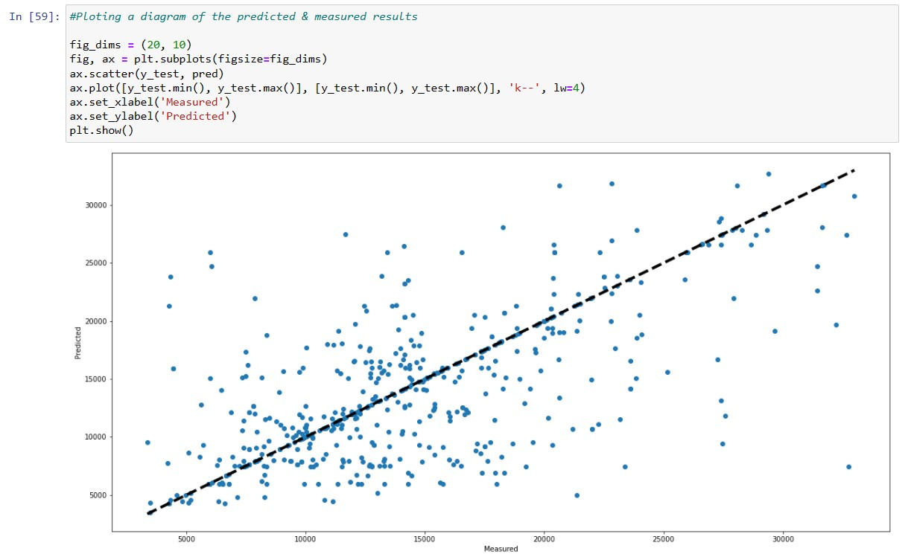
PLOTTING CURVE
The line shows the predicted & measured
results

Slide 27
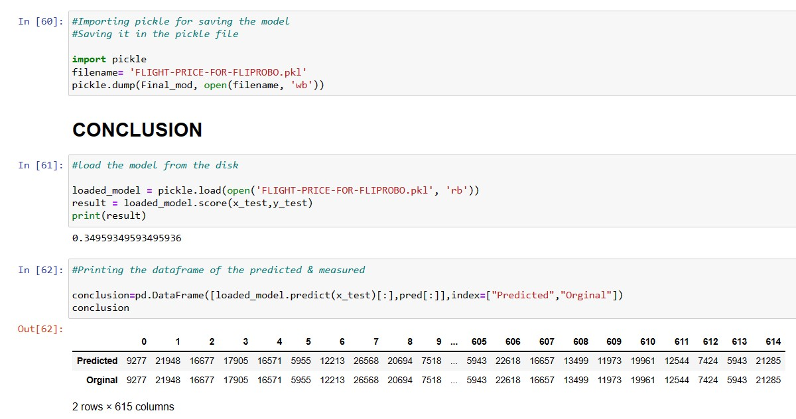
SAVING THE MODEL:

Slide 28
CONCLUSION

Slide 29
THANK YOU

